Slide 1
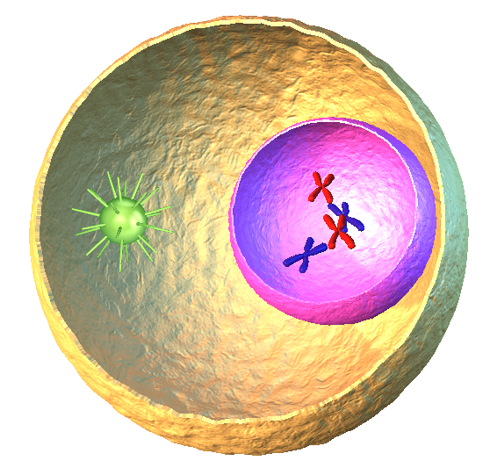


Duration: 130 min
Middle School
Grades: 6 - 8
CCSS, NGSS
Cell, basic structure of all living creatures
Life Science, Human Biology
Click to open in Lifeliqe

Slide 2



Lesson overview
Cells are the main building material of all living creatures. Whenever you zoom with a microscope into the flesh of a chicken or human, or into the leaf of a dandelion, you will definitely find somatic cells. In a human body, there are approximately 220 different types of somatic cells. Somatic cells of plants on the other hand contain special parts, which are able to produce oxygen under certain conditions, making plants vital to our survival.
Learning objectives
Keywords
Recognize and characterize somatic cell components.
Identify the parts which differ between somatic cells and plant cells, and characterize their purposes.
Define asexual reproduction (mitosis) and name its phases.
Somatic cell, Plant cell, Cell Wall, Cell membrane, Endoplasmic Reticulum, Golgi, Vacuole, Nucleus, Nucleolus, Mitochondria, Chloroplasts, Free Ribosomes, Cytoskeleton, Mitosis.
Standards
Common Core
CCSS Ela-Literacy WHST.6-8.7
Conduct short research projects to answer a question (including a self-generated question), drawing on several sources and generating additional related, focused questions that allow for multiple avenues of exploration.
CCSS Ela-Literacy SL.8.5
Integrate multimedia and visual displays into presentations to clarify information, strengthen claims and evidence, and add interest.
NGSS
MS-LS1-1.
Conduct an investigation to provide evidence that living things are made of cells, either one cell or many different numbers and types of cells.
MS-LS1-2.
Develop and use a model to describe the function of a cell as a whole, as well as the ways parts of cells contribute to the function.

Slide 3
1. Present the topic – Introduction to Somatic cells
10
min
At the start of the class, provide a short introduction to the somatic cell. Provide just basic information:
A somatic (from the Greek word meaning “body”) cell is any biological cell forming the shape of its organism, except for those cells involved in sexual reproduction (called gem cells). They are found in all living creatures of varying shapes and sizes. They contain two copies of each of their chromosomes (one received from each parent). Humans are a diploid (having pairs of chromosomes) organism, having 23 pairs of chromosomes in each somatic cell. Somatic cells also differ in their functions, and may include additional parts that make them sophisticated, e.g., plant cells contain chloroplasts, which are crucial for photosynthesis.
2. Discuss and question
10
min
Question the students to find out if the students already have knowledge about somatic cells. Encourage the students to use their own words.
How would you define a cell?
Is there any way to observe a cell? If so, what tool is most commonly used? What do you think keeps the somatic cell together?
Does a cell have anything resembling a skeleton? If so, what keeps it alive and organizes it?
Do you know some parts of somatic cells? Can you guess their function?
3. What does a somatic cell look like?
15
min
To show what a somatic cell looks like, open the 3D model of a “Somatic cell” located in the Lifeliqe Human Biology library. Highlight the individual parts by clicking on them, and talk about their function.
You can also turn the model around and zoom in on it to enlarge individual parts.
Below the model’s picture you can find a brief description of each of the main parts, including a memorable phrase, which students can use as keywords for quickly memorizing each part’s functions (a sort of learning cheat sheet of phrases). Encourage the students to invent their own keywords.

Slide 4
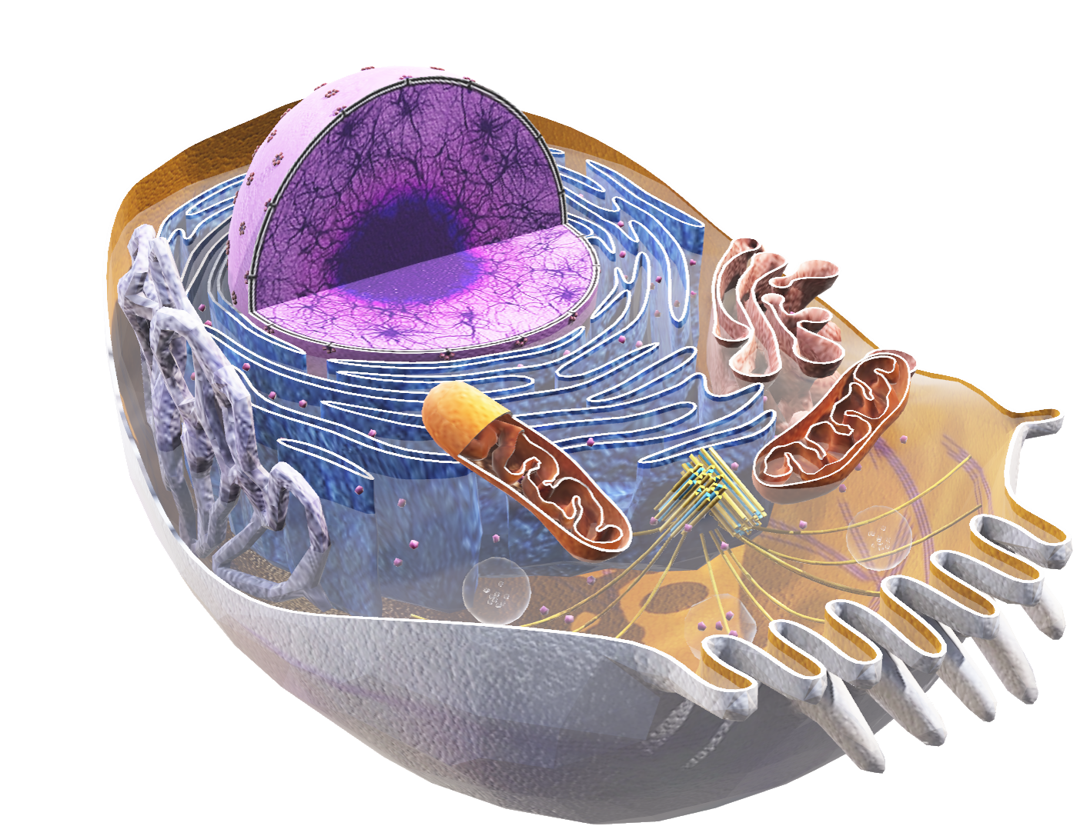

Name | Memorable phrase | Description
Plasma membrane | Cell’s fortification | Separates the interior of the cell from the outside environment
Cytoplasm | Cell’s environment | Fluid part enclosed by the membrane, contains organelles
Nucleus | Cell’s brain | Contains most of the genetic material, in the form of DNA
Endoplasmic Reticulum | Cell’s pipe system | System of metabolic processes (smooth ER), protein manufacturing ribosomes (rough ER)
Golgi apparatus | Cell’s delivery center | It tags vesicles and proteins to help them get carried to their correct destinations
Centrosome | Cell’s anchor | Organizes and produces the microtubules of the cell’s cytoskeleton
Mitochondria | Cell’s powerplant | Produce energy for the cell, break down carbohydrates and some Durations lipids to form molecule ATP
Ribosome | Cell’s factories | Translate RNA into proteins
Lysosome | Cell’s stomach | Vesicles filled with digestive proteins, can absorb something and break it down into recyclable pieces
Peroxisome | Cell’s firemen | Vesicles that defend (or neutralize) the cell from free radicals
Cytoskeleton | Cell’s shapeshifter | It modifies the cell’s shape and ensures mechanical resistance to deformation
Vacuole | Cell‘s compartments | Enclosed storage vessels which are filled with water containing inorganic and organic molecules
Click to open in Lifeliqe

Slide 5
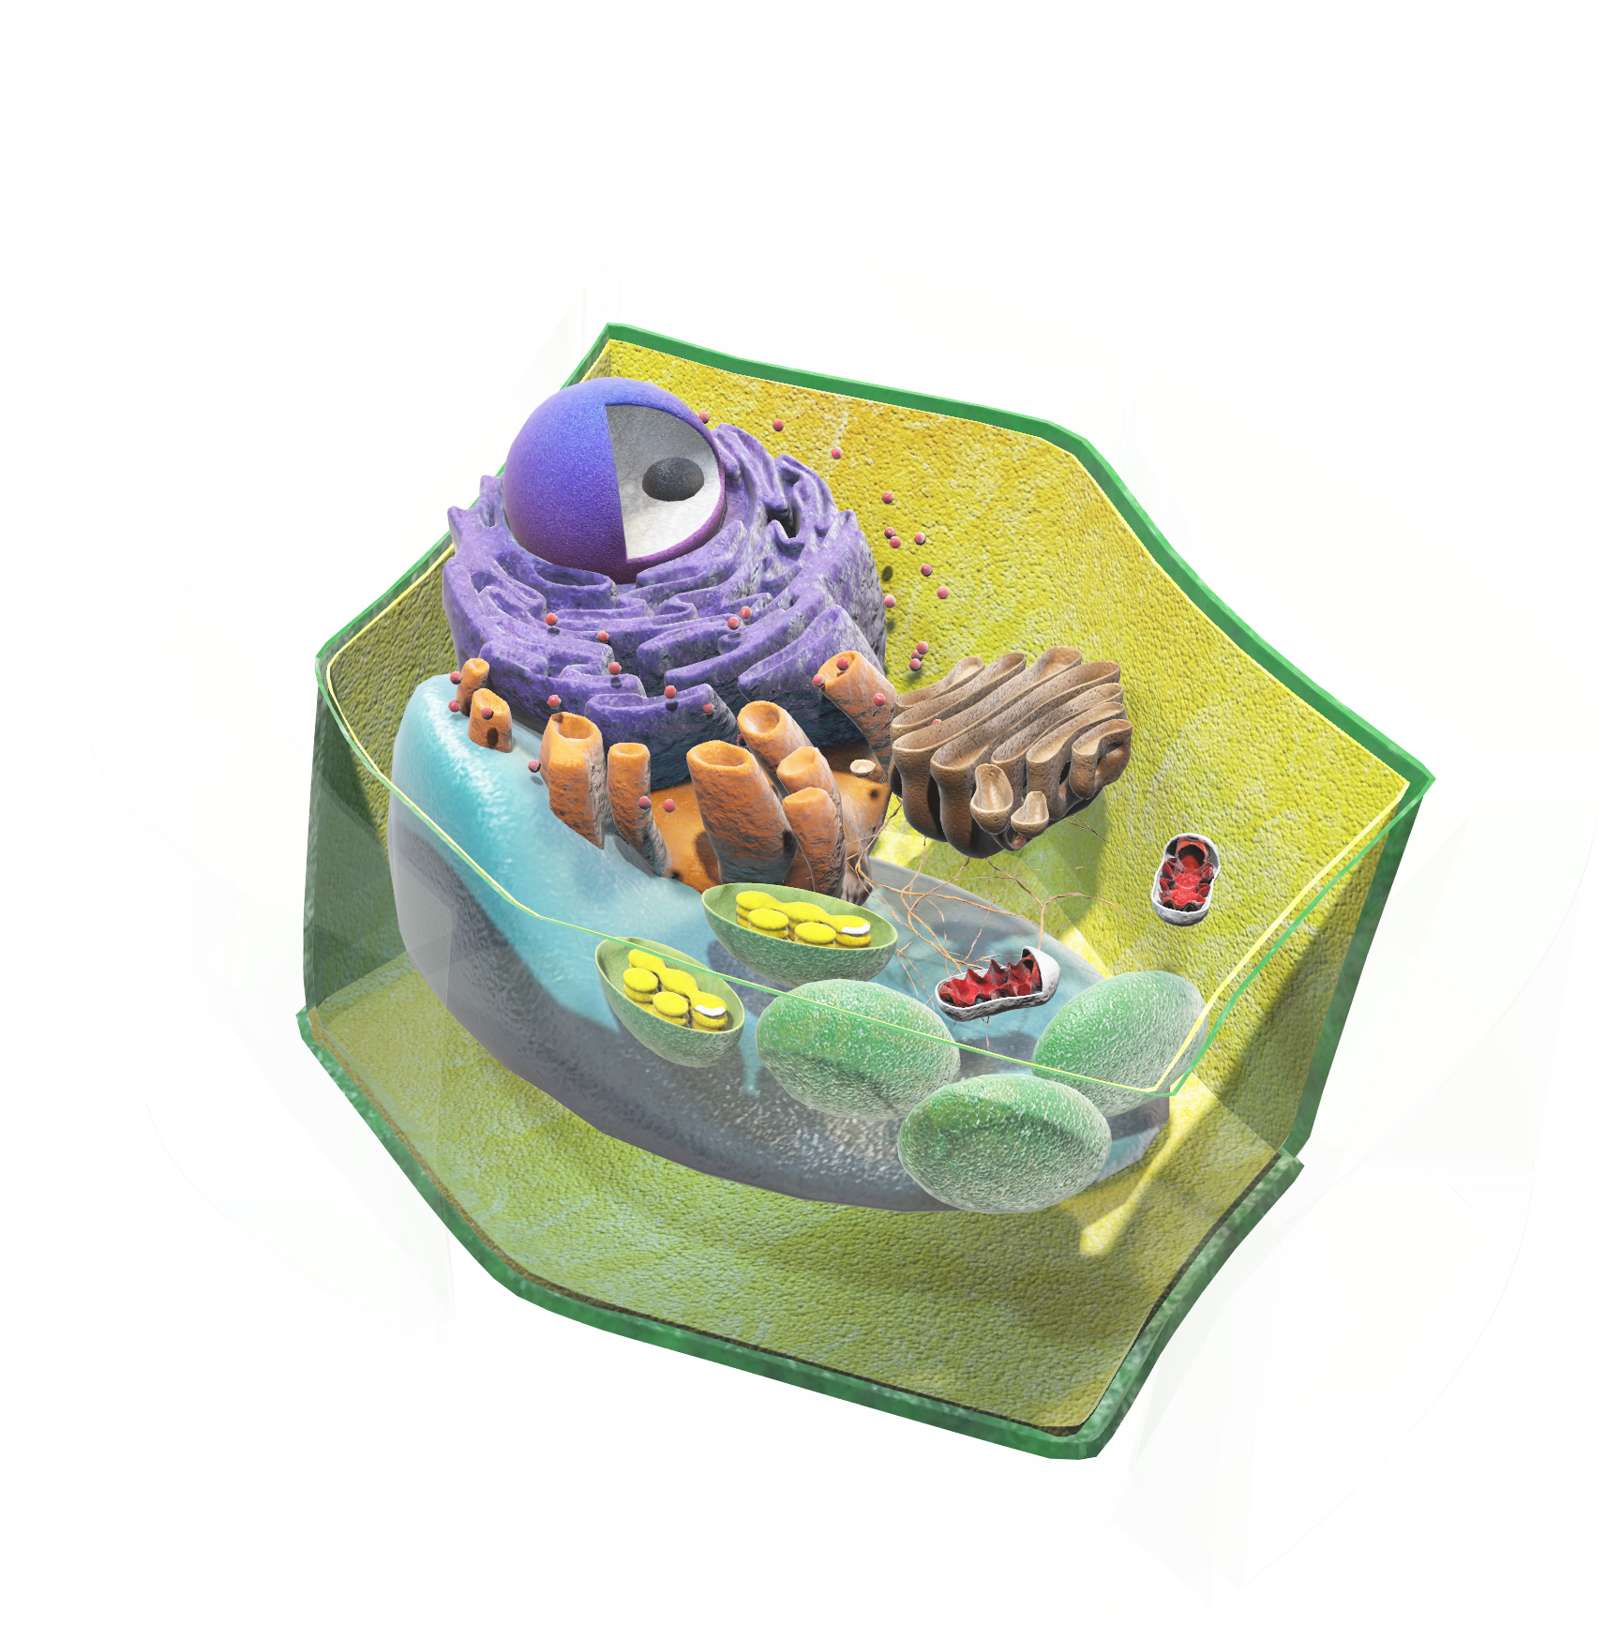
4. Plant vs. Somatic cell: Is there any difference?
5
min
Open the model of the “Plant cell” located in the Plant Biology library in the Lifeliqe app. Use the model to evaluate the parts of the cell your students are supposed to be familiar with already (based on their knowledge of somatic cells).
Point out the unknown parts which are specific to plant cells. Encourage students to make guesses and suggestions about the roles of these new parts. You can ask the following questions:
What might be the function of the chloroplast?
If a human’s cells contained chloroplasts, would we still need plants?
Make a brief introduction of Chloroplast and its role in the plant cell:
A chloroplast is an organelle specific to plant cells that contains chlorophyll, which make plants green. It is also responsible for enabling the essential chemical process called photosynthesis. Thanks to it plants can convert sunlight into chemical energy and feed themselves. At the same time they are producing a valuable resource for mankind, oxygen, which we need for our survival.
Click on the model to interact

Slide 6
5. Activity – Every cell is unique
25
min
Tools:
Paper, Crayons, Computer with interactive board or data projector, Lifeliqe “Somatic cell” 3D model.
Instructions:
Form groups of 3-4 students. These groups will have to draw their own somatic cell of various shapes with their appropriate parts.
The instructor will personally assign by name each group a part of the somatic cell they should omit. Then the individual group must correctly identify the missing part and determine what ability or characteristic the somatic cell would lose without it.
After 10 min., ask every group to come in front of the class and present their own somatic cell. The other students are encouraged to determine the missing object and evaluate its lost factor. The group presenting then checks the correct answers of their classmates. Compare the drawing with the LifeLiqe 3D model of a somatic cell.
6. Explain the subject topic – How a cell divides: Mitosis
10
min
Provide basic information about Mitosis. You may also elicit the beginning of the topic with a question concerning reproduction.
Mitosis describes a process in which chromosomes in a cell nucleus are separated into two identical sets, each ending with its own nucleus. It is referred to as a division of the nucleus.
It is often followed by cytokinesis, which divides the cytoplasm, organelles, and cell membrane into two new cells with an equal share of these parts.
7. Activity – How do cells reproduce?
10
min
Duration:
10 minutes preparation
15 – 20 minutes (depending on the number of groups)
Tools:
Computer (with or without Internet connection), data projector or interactive board, LifeLiqe “Mitosis” 3D model, PowerPoint or Keynote
Preparation:
Prepare screenshots of the Mitosis model with the following phases using the Share function of the Lifeliqe app. Mix the slides so that the phases are not in order.
You can prepare more presentations with mixed variations. You can see the correct order in table 1.
Prepare a file document with the names and brief descriptions of the phases, which can be found in a table 1. You can use your own.

Slide 7
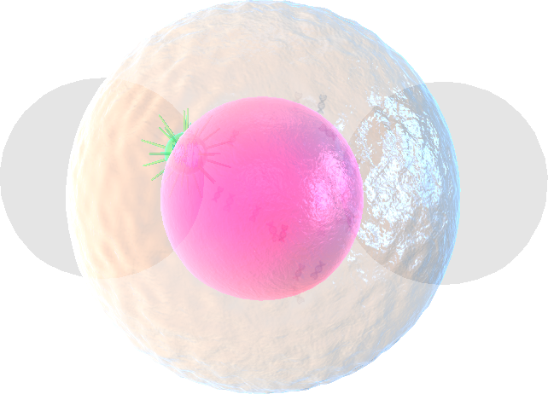
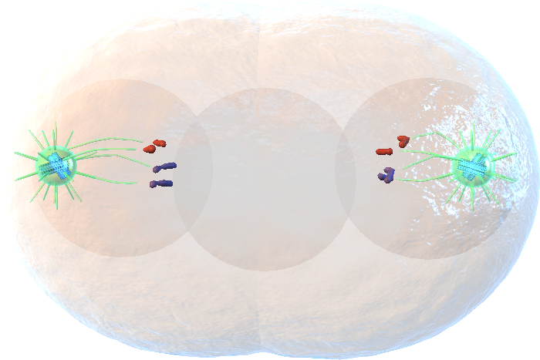
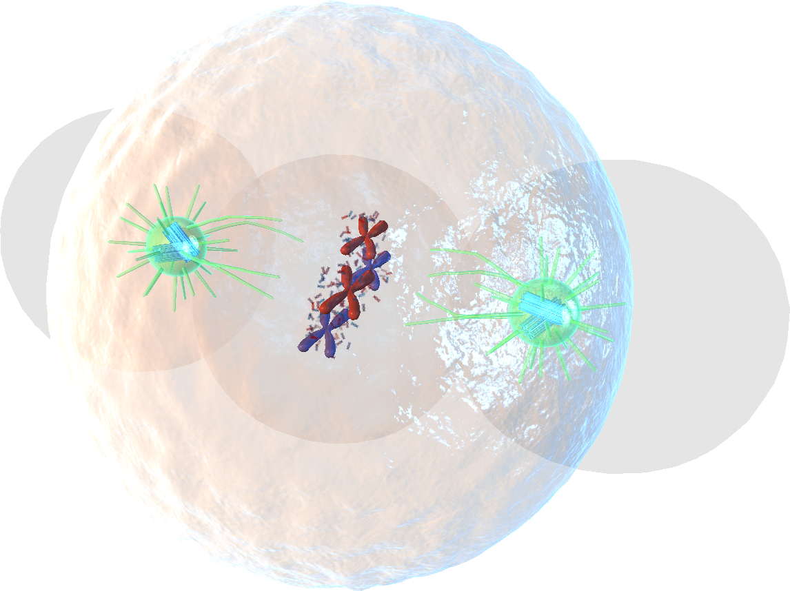
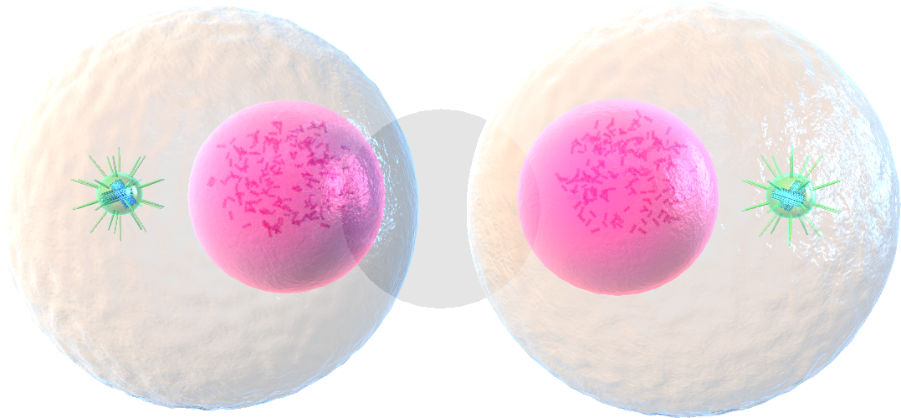
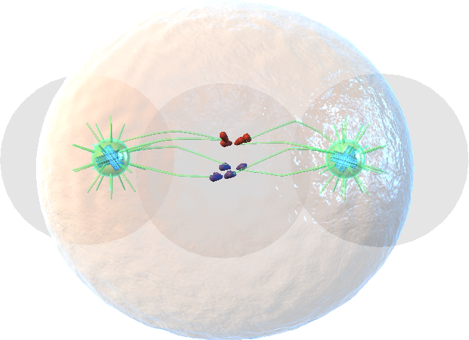
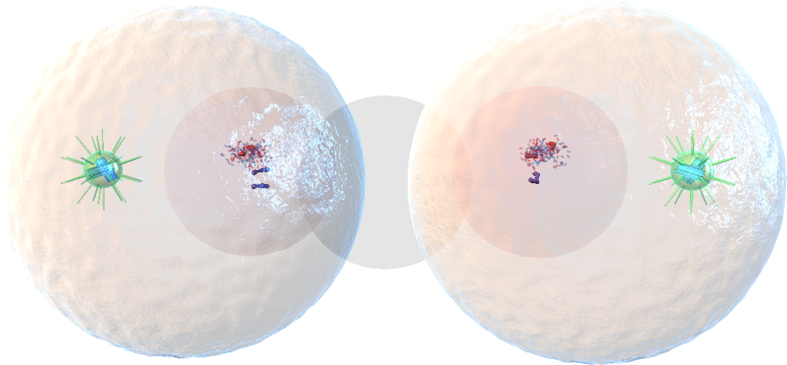
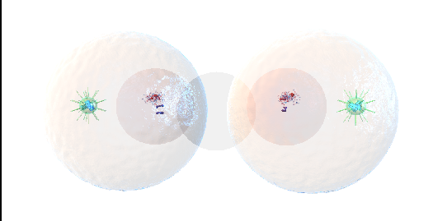
Interphase: The cell is undertaking metabolic activity and preparing for the asexual reproduction (mitosis).
Prophase: Chromatin in the nucleus starts to condense, resulting in the nucleolus disappearing. Centrioles move to opposite ends of the cell.
Prometaphase: Prometaphase is marked by the dissolution of the nuclear membrane. Kinetochores are created by proteins attached to the centromeres. Chromosomes start to move.
Metaphase: Chromosomes are aligned by spindle fibers along the center of the cell nucleus. This ensures the proper chromosome separation for each new nucleus.
Anaphase: The paired chromosomes separate and move to opposite sides of the cell. Telophase: Chromatids arrive at opposite poles of the cell, new membranes form around the nuclei.
Telophase: Chromatids arrive at opposite poles of the cell, new membranes form around the nuclei.
Instructions:
Form groups of 6 students.
Provide students with the presentations and document file.
Students should find the correct order of phases and write down the correct descriptions to them. They can use Lifeliqe “Mitosis” model and Internet to help themselves.
After a given duration for their preparation (5–7 minutes), have them present their results. Each of the students should describe one phase (or more if you choose smaller groups).
If any mistakes in the order of the images are made or if the text parts are incorrectly attached to the images, try to correct them through a series of questions.
Click to open in Lifeliqe

Slide 8
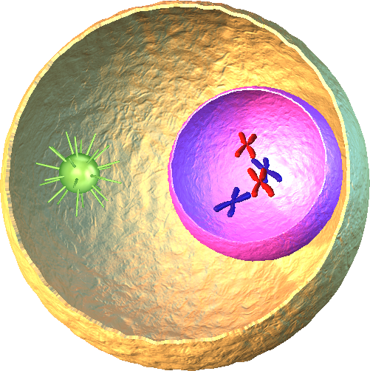
8. Present the topic - Mitosis in real life
15
min
Connect to the previous activity. Open the model of “Mitosis” located in the Human Biology library in the Lifeliqe app. Here you can show the animation, stopping it whenever you want to describe a phase.
1.
Spindle Fiber
2.
Centrosome
3.
Nucleus Membrane
4.
Chromosome
5.
Centriole
6.
Cell membrane
Click to open in Lifeliqe

Slide 9
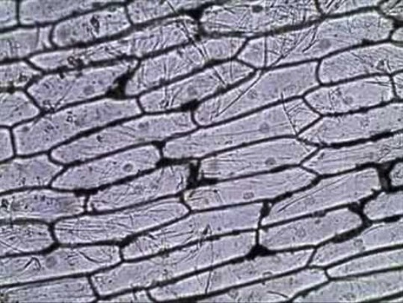

9. Activity – See the world of a cell inside an onion
10
min
Tools: Microscope, slice of onion.
Slice an onion and place a sample of it under a microscope. You should be able to zoom in to a sufficient degree of detail to see the cells alone. If zoomed deeply enough, the nucleus of each cell can be seen as a shadow dot.
This experiment should raise the following questions:
Do cells need a source of nutrients in order to thrive and develop? If so, what internal parts of the cell ensure food storage?
What is a visible result of the mitosis process of the cell in the onion? (The growth of the onion and its development.)
Will the sliced part of the onion be able to thrive and develop further? (Question for discussion.)
"Onion Skin Epidermal Cells: How to Prepare a Wet Mount Microscope Slide" by Tami Port is licensed under CC BY 2.0

Slide 10

Thanks for using Lifeliqe's lesson plan!
Excite your students in learning science with 1,000+ more 3D models and lesson plans at online.lifeliqe.com

